Slide 1
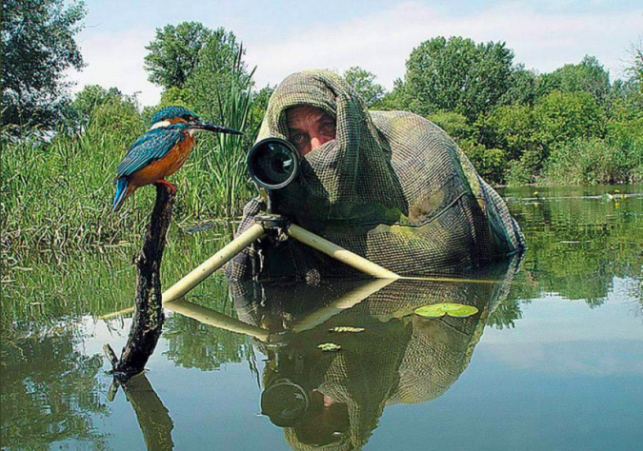
[Twentytwowords, Anthony, 2018]

Slide 2
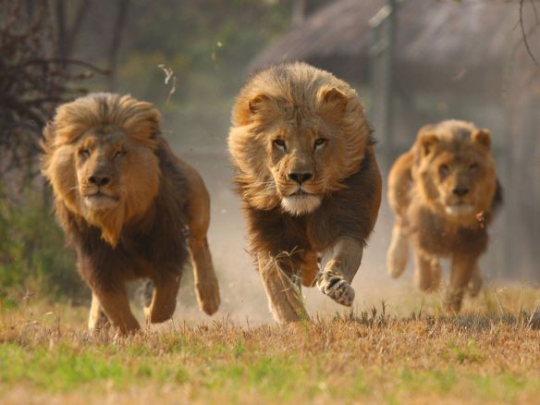
[Charging Lions, Murphy, 2015]

Slide 3

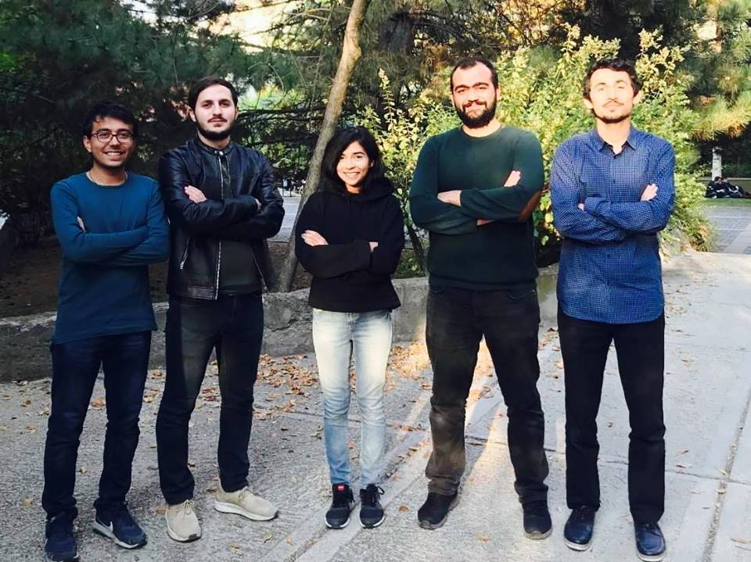

Slide 4
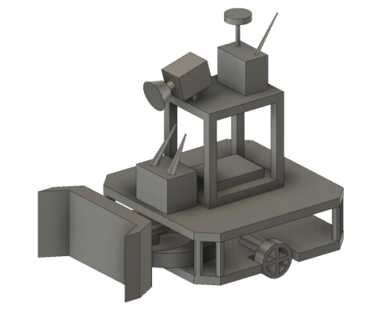
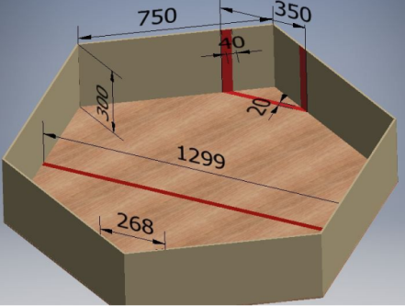
Problem Statement
-Remotely Operated Robots
-Hexagonal Playfield
-Ball may not be scooped or carried by the robots
- Wi-Fi Protocol or Wired Connections Prohibited
-Confinement to only half of the entire playfield
- Ball Transferred to Opponent’s field within 20s
-Target Budget: $ 200

Slide 5
Expectations
Effective Obstacle Avoidance
Low latency Video Transmission
Strong Yet Low Powered Shooting Mechanism
Efficient Defense and Attack Maneuvers
Economical Yet Cost Effective Solutions

Slide 6
Outline
Transmission Subsystem
Electro-Mechanical and Power Subsystem
Control and Sensor Subsystem
Conclusion

Slide 7
Transmission Subsystem
Recep GÜNAY

Slide 8
Problem Statement and Requirements
Range:
A range of up to 30m
Interference:
Interference free
Latency:
Low latency

Slide 9
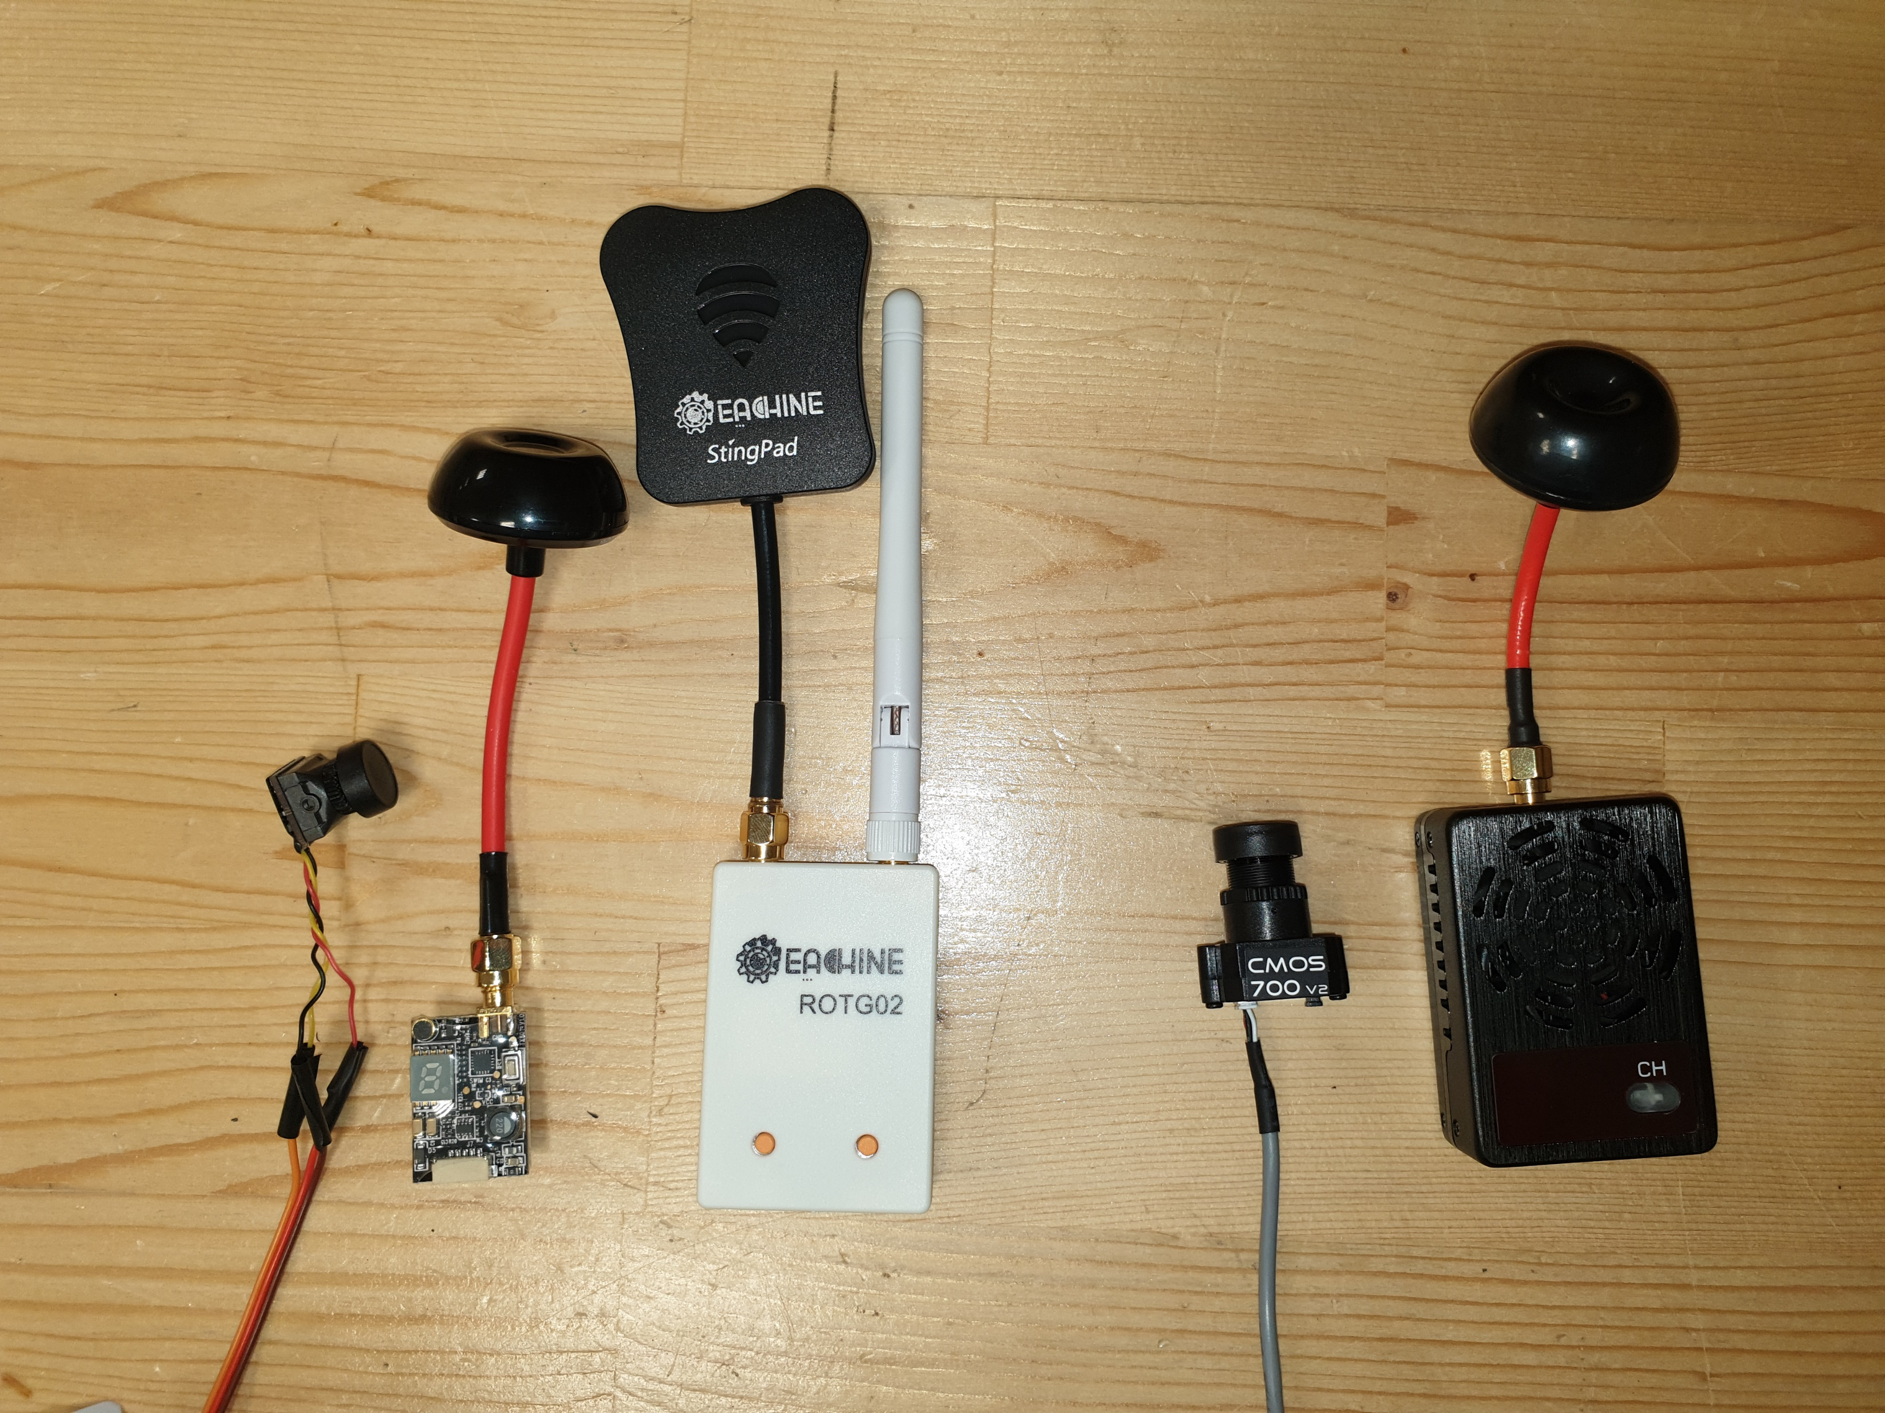
Hardware Implementation

Slide 10
Solutions
Range:
Omni-directional antenna
Diversity receiver
Interference:
Circular Polarized Waves
Low signal power
Multiple channels in different band
Latency:
Lower image quality to decrease latency
Analog video output

Slide 11
Test Results
Range:
200m in line of sight
40m with obstacles
Interference:
No multipath interference
No interference with another system in different channels
Latency:
Less than 80ms within a 10m radius
Up to 200ms at around 30m

Slide 12
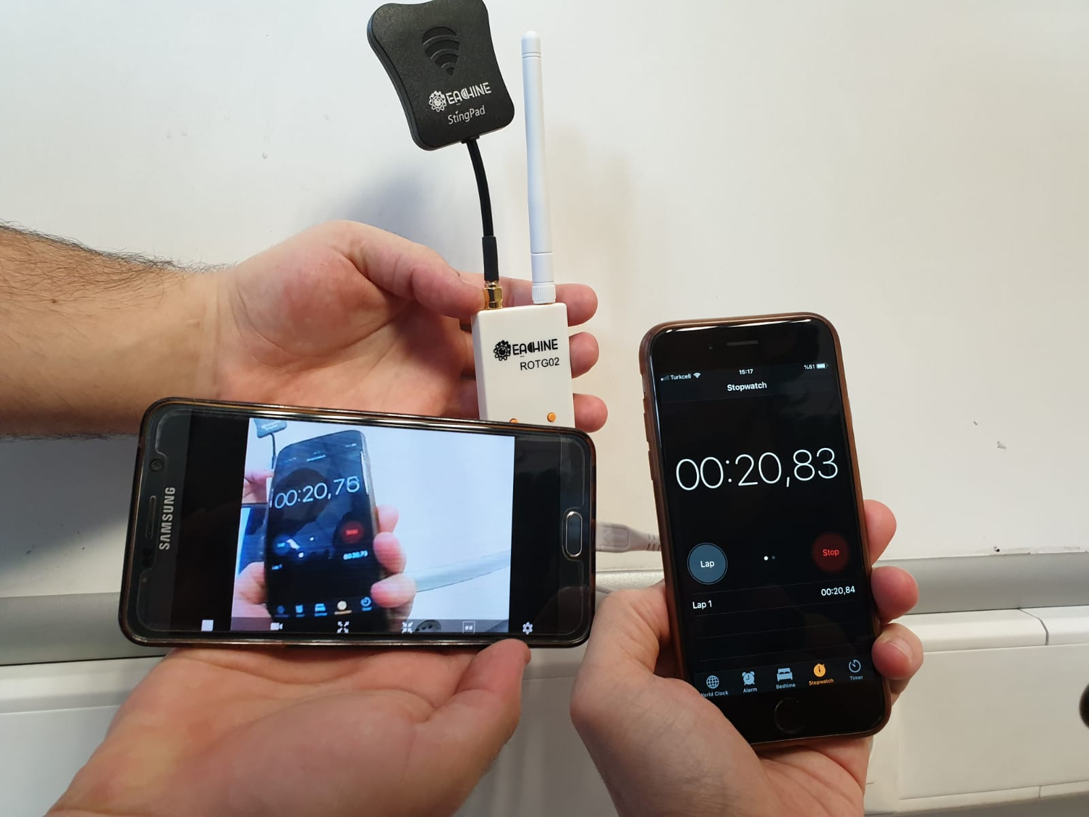
Test Results

Slide 13
Alternative Solutions
3G/4G modules
Upload and download video anywhere
Feature transmission
Image processing

Slide 14
Electromechanical & Power Subsystem
Huzeyfe Hintoglu

Slide 15
Outline
Mechanical Design
Actuator System Design

Slide 16
Mechanical Design
Objectives&Requirements
Light and Compact Design
Neatness
Durability (Mechanically)

Slide 17
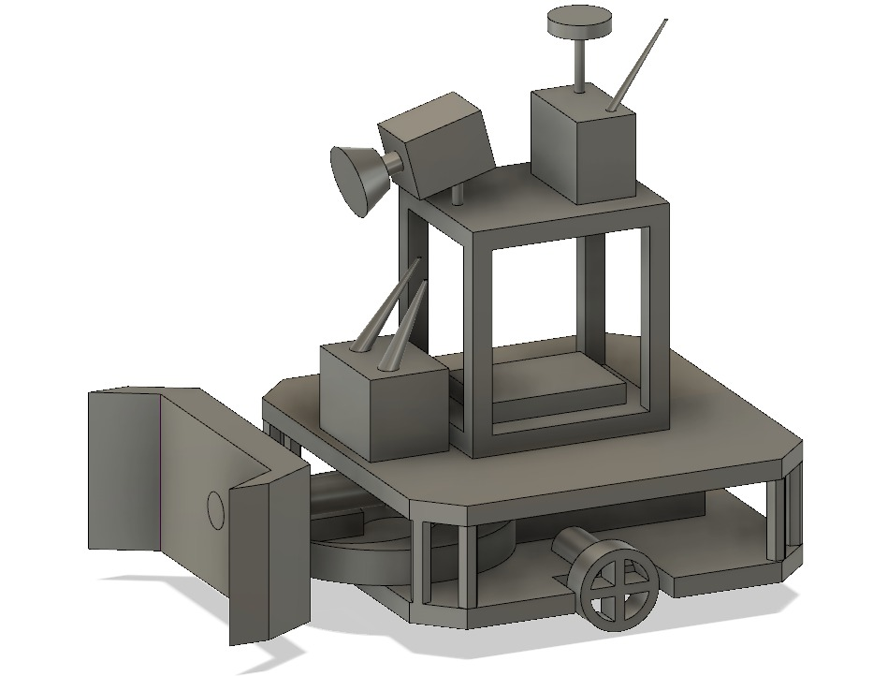
Mechanical Design

Slide 18
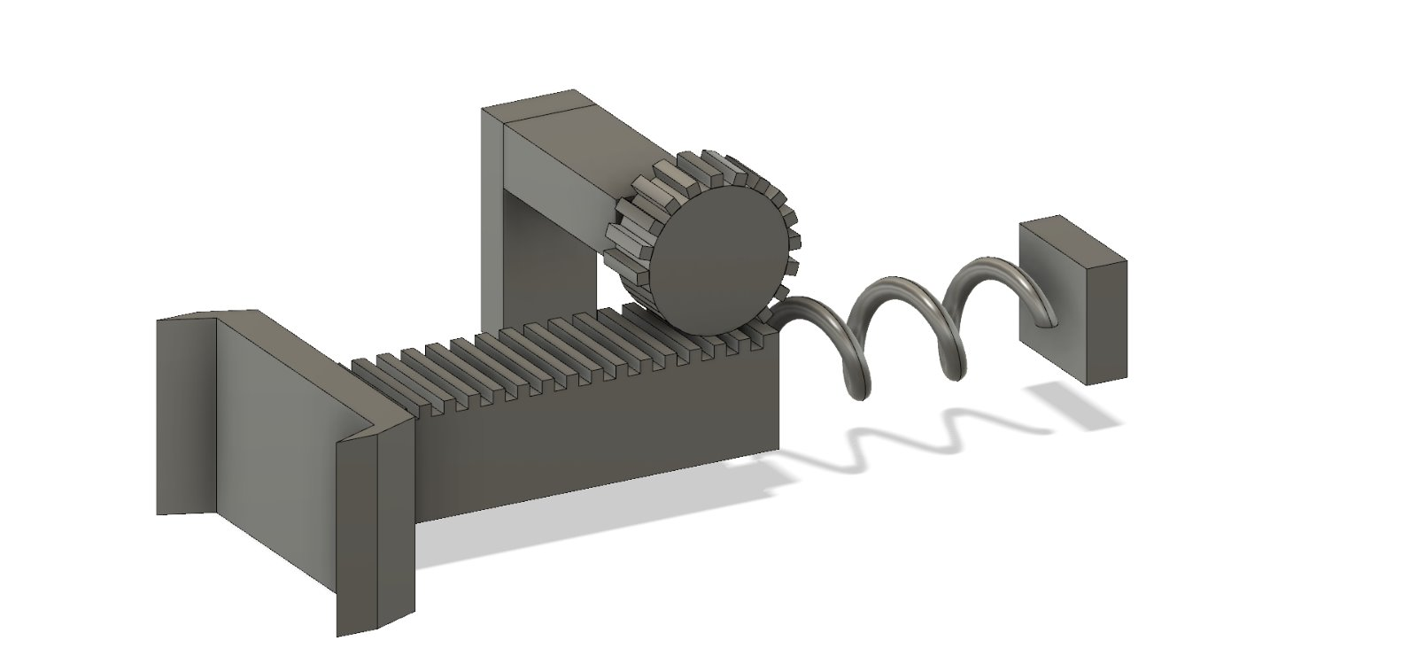
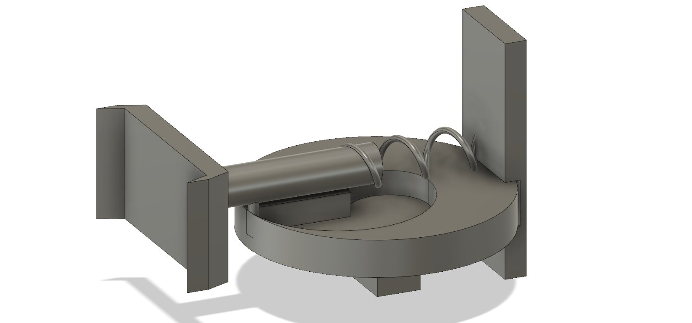
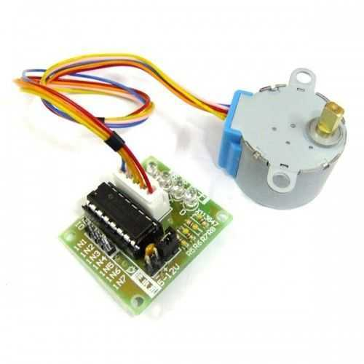
Shooting Mechanism
Retrieved from: Ebay UK (n.d.)

Slide 19
Actuator System
Objectives&Requirements
Agile Movement
Durability (in Power Aspect)
Inexpensive

Slide 20
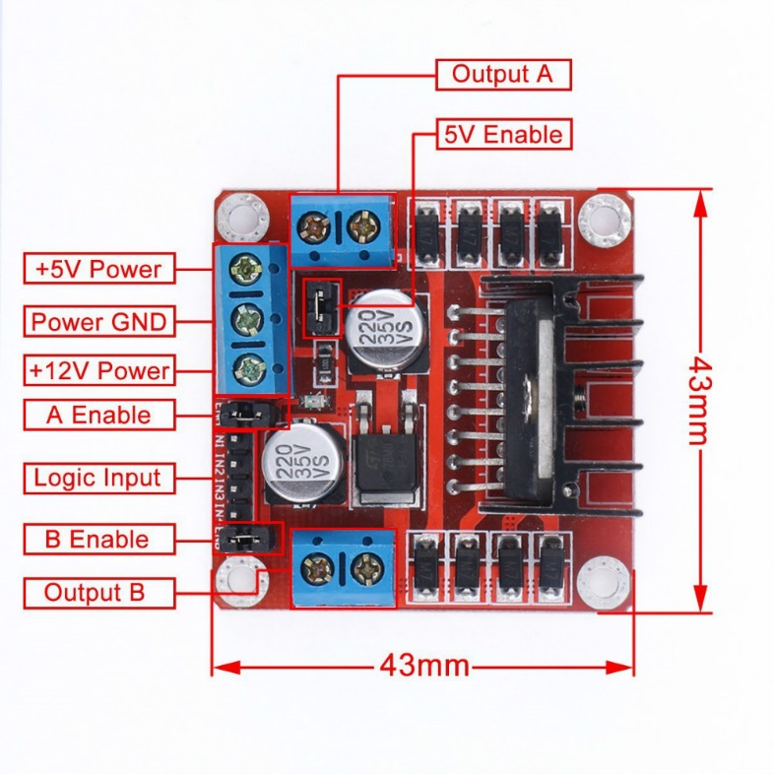
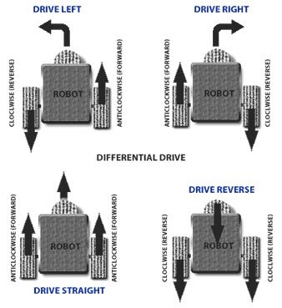
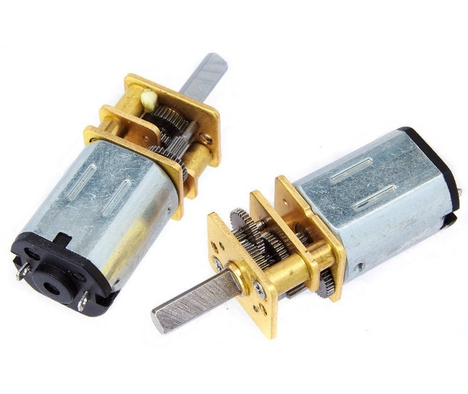
Agile Movement
Retrieved from: iFuture Technologies (n.d.)
Retrieved from: Robot Platform (n.d.)
Retrieved from: Robotzade (n.d.)

Slide 21
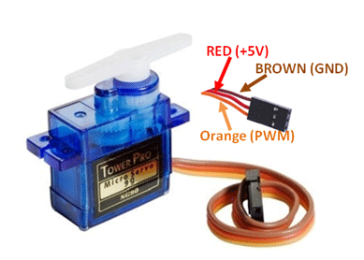
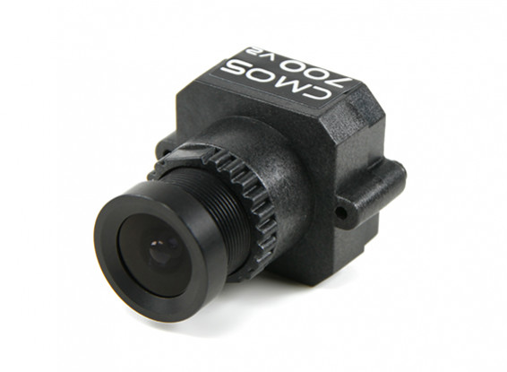
Camera Movement
Retrieved from: Components101 (2017)
Retrieved from: HobbyKing (n.d.)

Slide 22
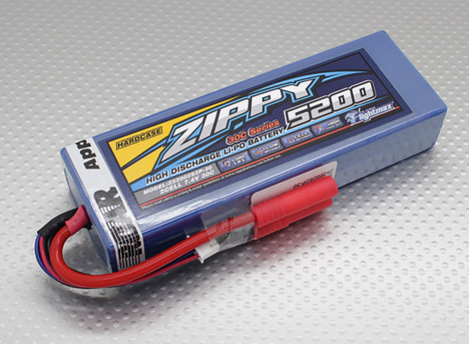
Power
5200maH
Li-Po
2Cell 7.4V
30C
[1] Retrieved from: HobbyKing (n.d.)
Retrieved from: HobbyKing (n.d.)

Slide 23

Power Analysis of Robot
Component | Power Consumption
Shooting Mechanism | 0.45W (One shot)
Camera Movement | 0.42W (Continous Rotation)
Camera | 1W
Transmitter | 3.5W
Motor Movement | 4.8W
Reciever | 0.2W
Total | 10.37W
Battery Capacity | 38.5 Wh
Time = Battery Capacity/ Total = 4 Hours

Slide 24
Control Subsystem
Fatih ÇALIŞ

Slide 25
Problem Statement and Requirements
Good Control Algorithm
High Maneuver Capability
User Friendly Operation
3 Continuous Variables
2 Digital Variables

Slide 26
Solutions
Differential Drive Method
Rotation around its own axis

Slide 27
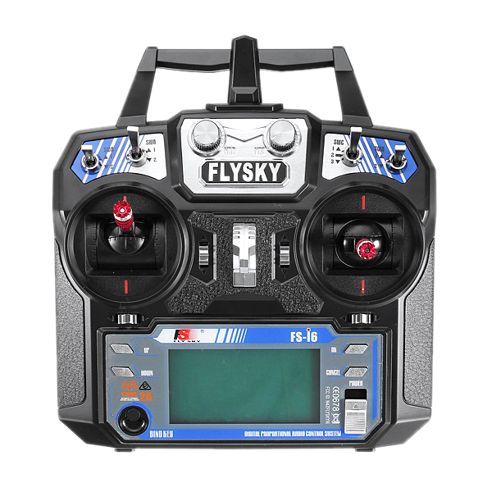
3 Continous Variables:
Movement in Y direction
Movement in X direction
Angle of FPV camera
2 Digital Variables:
Shooting Action
Choosing Mode
Retrieved from: Banggod.com

Slide 28
Implementation
Sensors
RC Transmitter
Microcontroller
Servo Motor
RC Receiver
FPV Display
FPV Camera
Motor Driver
Motor Driver
DC Motors
Step Motor
Remote Control
On-Board Control

Slide 29
Test Results
RC Transmitter Tests:
Range:
Line of Sight : Around 250m
With Obstacles: Around 100m
Sensor Tests:
Distance Sensor (HCSR-04):
Measurement Range: 1cm – 400cm [4]
Without Delay : 1cm – 50cm
Color Sensor (TCS3200)
Requires good threshold adjusting

Slide 30
CONCLUSION
FATİH ÇAM

Slide 31
DELIVERABLES
Equipments
Documents
Software

Slide 32
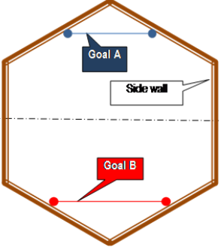
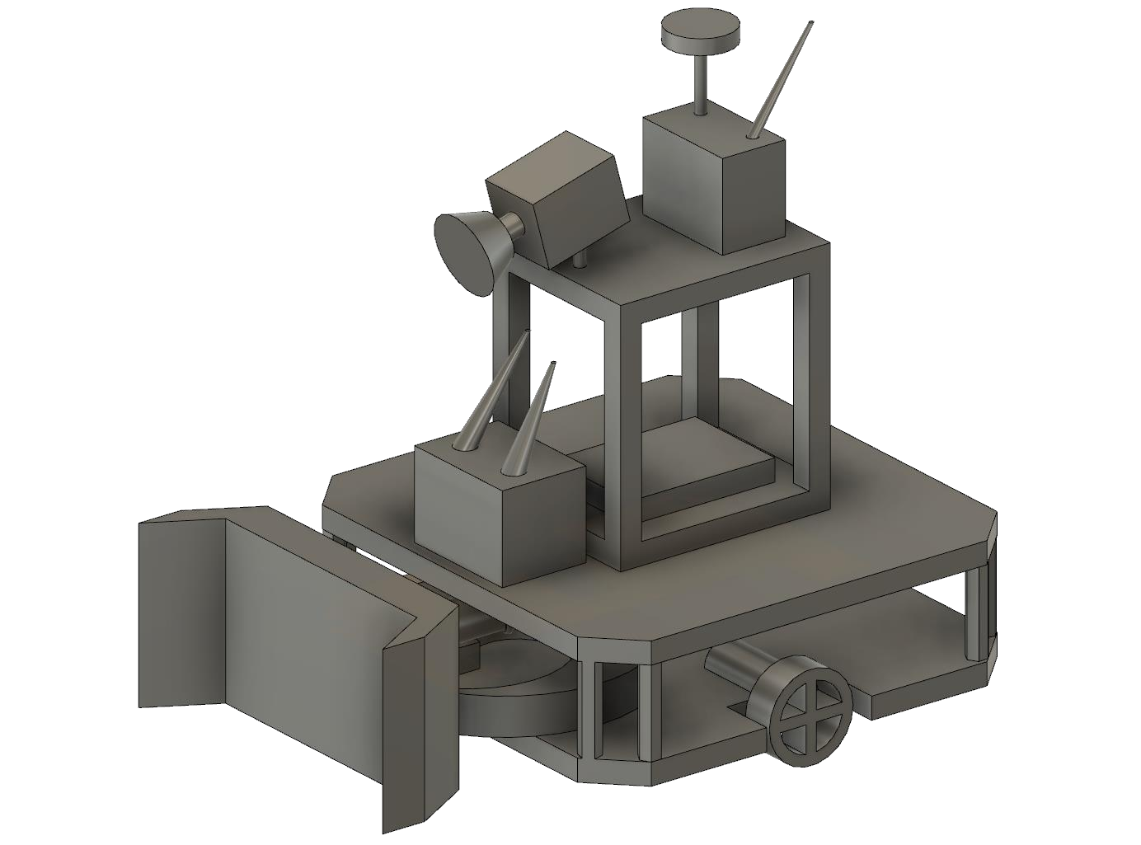
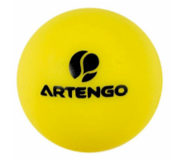
EQUIPMENTS
Vehicle(Robot)
Play Field
Ball
Goals
Control Interface

Slide 33
DOCUMENTS and SOFTWARE
Warranty
Manual
USB Flash Memory

Slide 34
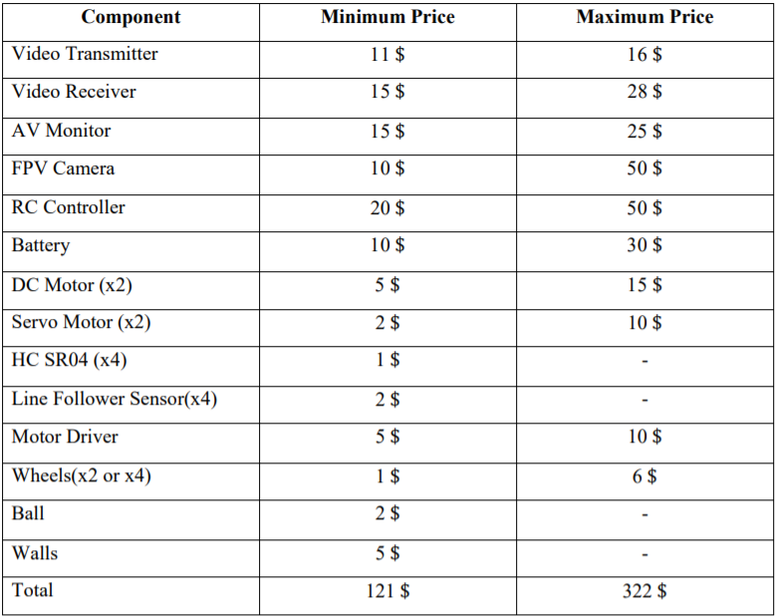
COST ANALYSIS

Slide 35
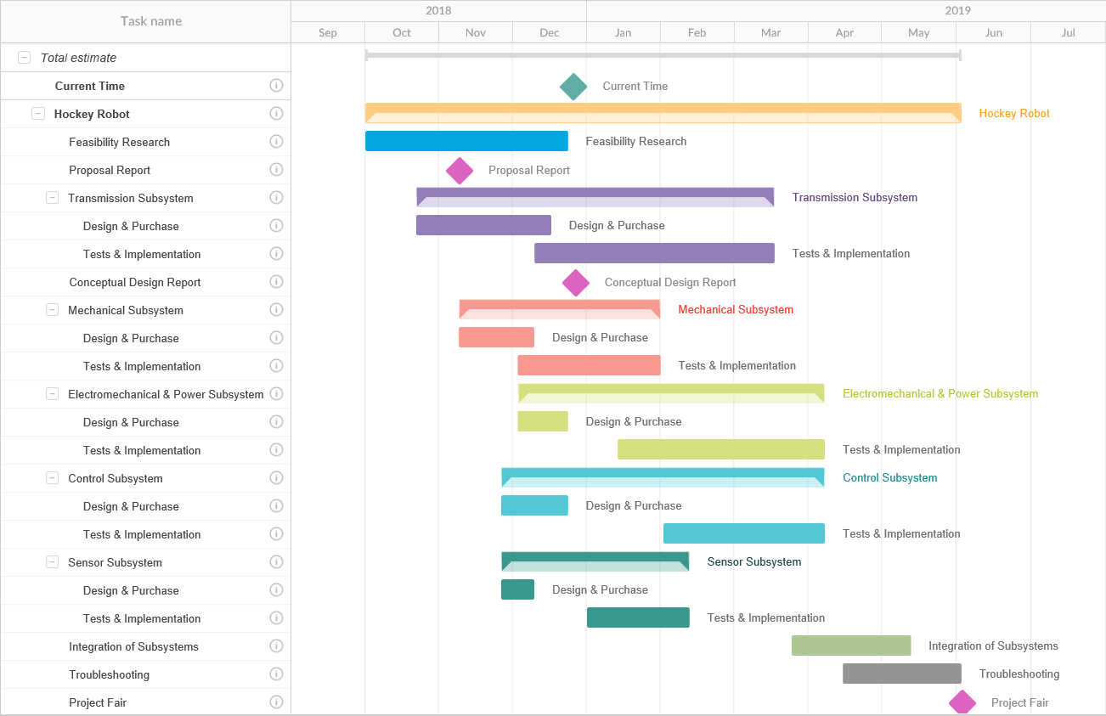

Slide 36
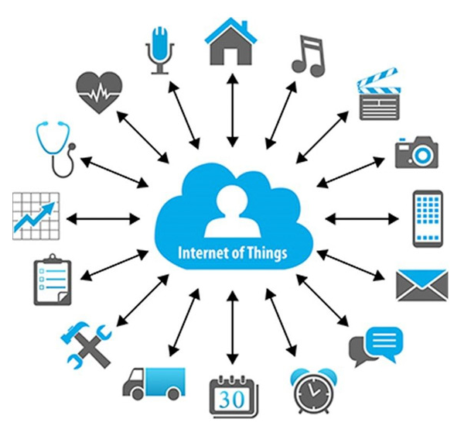
FUTURE PLAN
Retrieved from: justcreative.com

Slide 37
References
[1] A. M. (n.d.). Twenty Two Words. Retrieved 2018, from https://static.twentytwowords.com/wp-content/uploads/Screen-Shot-2018-08-14-at-2.19.28-PM-675x474.png?fbclid=IwAR2DfbmaA_2RJD-hNQm5DRuFsQ1oEkLxTELoyMv1U1DuKNQjRdpRvPesLcg
[2] Gylenhall, M. (n.d.). Charging Lions. Retrieved 2015, from https://www.360nobs.com/2016/03/pastor-critical-condition-challenging-lions-national-park-prove-power/charging-lions/
[3] ZIPPY Flightmax 5200mAh 2S2P 30C Hardcase Pack (ROAR APPROVED). (n.d.). Retrieved from https://hobbyking.com/en_us/zippy-flightmax-5200mah-2s2p-30c-hardcase-pack-roar-approved-de.html
[4] M. (n.d.). Ultrasonic Ranging Module HC - SR04. Retrieved January 03, 2019, from https://www.mouser.com/ds/2/813/HCSR04-1022824.pdf
[5] J.M. (2018, November 19). Internet of Things: What It Is, How It Works, Examples and More. Retrieved January 02.01.2019 from https://justcreative.com/2018/11/19/internet-of-things-explained/

Slide 38
References for Images
5V Stepper Motor 28BYJ-48 With Drive Test Module Board ULN2003. (n.d.). Retrieved from https://www.ebay.co.uk/itm/2PCS-5V-Stepper-Motor-28BYJ-48-With-Drive-Test-Module-Board-ULN2003-5-Line-4-Pha-/191877872118
Robot Platform | Knowledge | Wheel Control Theory. (n.d.). Retrieved from http://www.robotplatform.com/knowledge/Classification_of_Robots/wheel_control_theory.html
L298 Stepper Motor Driver. (n.d.). Retrieved from http://www.ifuturetech.org/product/dc-stepper-motor-drive/
6V 350Rpm Redüktörlü Mikro DC Motor. (n.d.). Retrieved from https://www.robotzade.com/6V-350Rpm-Reduktorlu-Mikro-DC-Motor,PR-1171.html
FatShark 700TVL CMOS FPV Camera V2 NTSC/PAL. (n.d.). Retrieved from https://hobbyking.com/en_us/fatshark-700tvl-cmos-fpv-camera-v2-ntsc-pal.html
Servo Motor SG-90. (2017). Retrieved from https://components101.com/servo-motor-basics-pinout-datasheet
ZIPPY Flightmax 5200mAh 2S2P 30C Hardcase Pack (ROAR APPROVED). (n.d.). Retrieved from https://hobbyking.com/en_us/zippy-flightmax-5200mah-2s2p-30c-hardcase-pack-roar-approved-de.html
FlySky i6 Transmitter. (n.d). Retrieved From https://www.banggood.com/tr/FlySky-FS-i6-2_4G-6CH-AFHDS-RC-Transmitter-With-FS-iA6-Receiver-p-922606.html?ID=42482&cur_warehouse=CN
J.M. (2018, November 19). Internet of Things: What It Is, How It Works, Examples and More. Retrieved January 02.01.2019 from https://justcreative.com/2018/11/19/internet-of-things-explained/

